Slide 1

User manual “ShopAdmin”
Software User Manual version 0.1.0,
26. February 2016

Slide 2
CONTENTS
Step 1 Registration…………………………………………………………………………...3
Step 2 Login………………………………………………………………………………….4
Step 3 Main view…………………………………………………………………………….5
Step 4 Scan receipt…………………………………………………………………………...6
Step 5 Check results………………………………………………………………………….7
Step 6 Main view with summary…………………………………………………………….8
Step 7 Reports view………………………………………………………………………….9

Slide 3
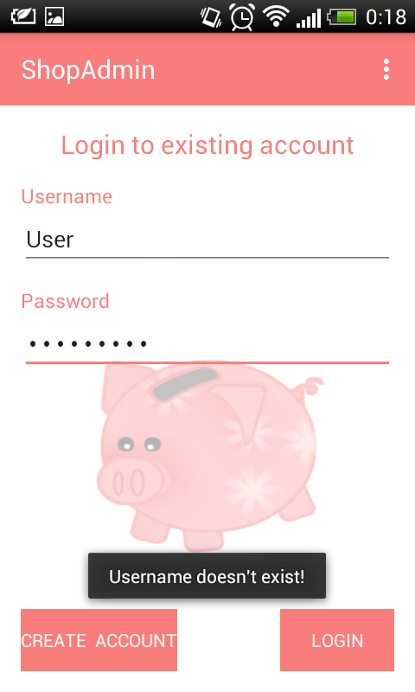
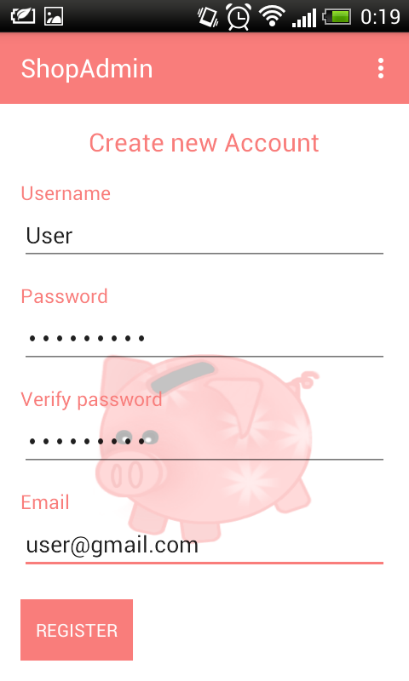
Step 1 Registration
How to use ShopAdmin
If you aren’t already registered:
Tap on a Button “Create new account”. A new “Register” Window appears. The program automatically asks for a new user name with a password and email.
Enter user name in the "User name" field. The program will automatically check, whether a specified name already exists in database or not. If a specified name already exist, an error message appears. This name will be used as a login.
Enter password in the “Password" field. The password must be at least 4 characters long.
Enter password one more time in the “Verify password” field to verify above specified password. If these two passwords are not the same an error message “These Passwords don't match. Please, try again!” appears.
Enter a valid Email in the “Email” field, in case a user forgets his/her password, it can be requested via specified email.
1.
2.
3.
4.
5.

Slide 4
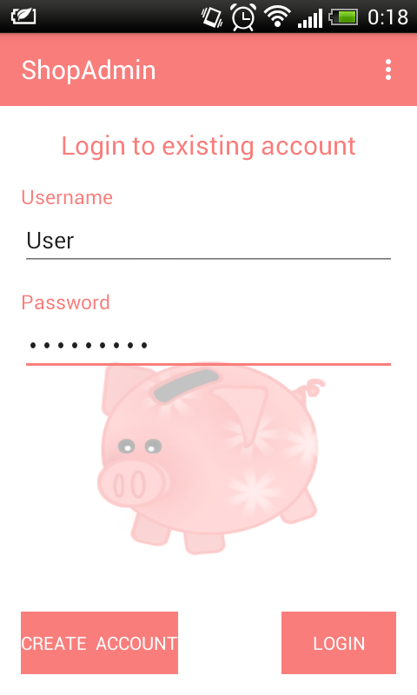
Step 2 Login
How to use ShopAdmin
If a user wants to start “ShopAdmin” Application, the program automatically asks for a login name with a corresponding password, so that no unauthorized user can access personal data from database:
Enter user name in the "Username" field.
Enter your correct password below the “Password" field.
1.
2.

Slide 5
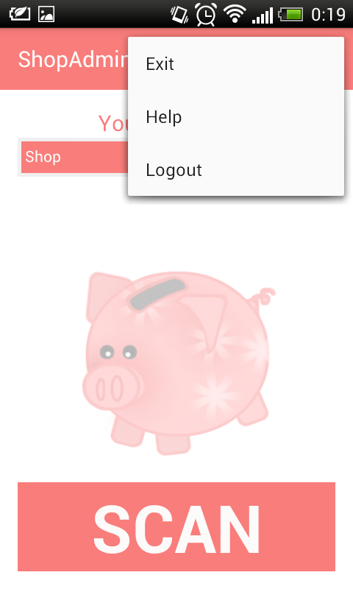
Step 3 Main page
How to use ShopAdmin
After your successful registration, you will land to the main page of “ShopAdmin”. You will see an empty Table (1.), which will later contain a list of receipts that you have scanned with your camera. This list will allow you to see the 20 most recently scanned receipts.
2. You can tap on button “SCAN” at the bottom to scan a new receipt.
3.You can tap on Menu in the top right corner and choose from the options:
- “Help” to get information on how to make a right photo of a receipt.
- “Exit” to close the application.
- “Logout” to switch to the login page.
4. You can tap on the receipt table to switch to the reports page that contains receipts sorted by shop name or shop category.
3.
3.
1.
4.
2.

Slide 6
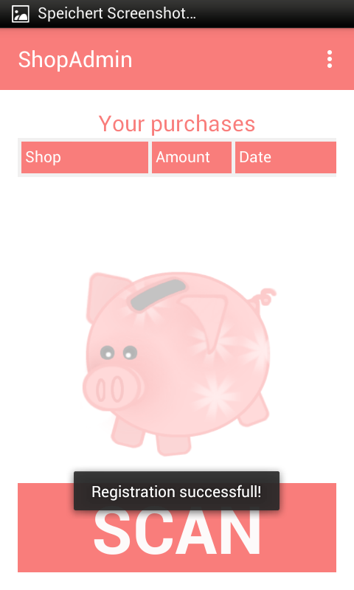
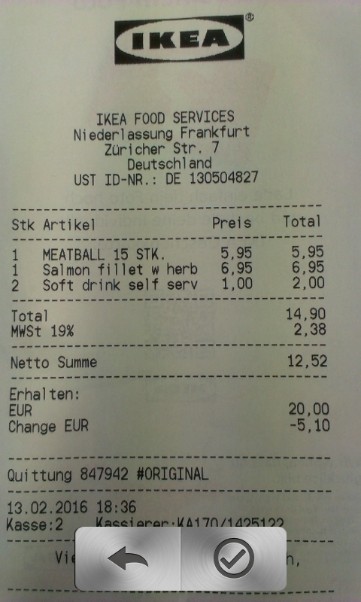
Step 4 Scan Receipt
How to use ShopAdmin
1. You can tap on button “SCAN” at the bottom to scan a receipt.
Camera mode will be started and you can take a picture of your receipt.
If a picture is not accurate enough:
2. Tap on Rescan to rescan a receipt.
In background an OCR program (optical character recognition) will recognize all characters of the receipt and save the results.
1.
2.

Slide 7
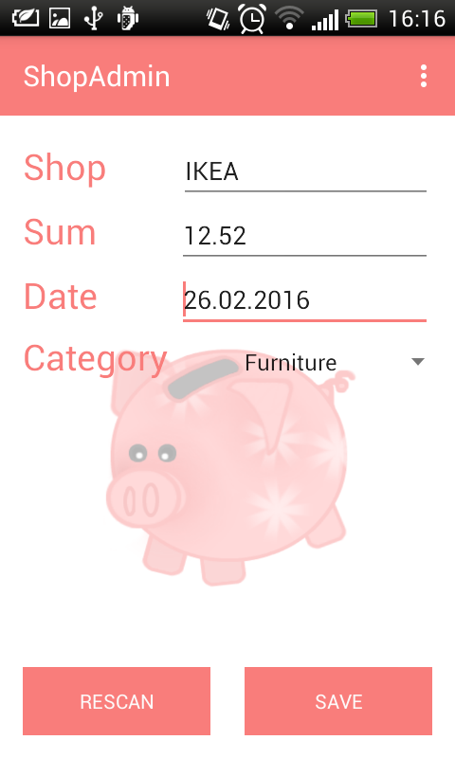
Step 5 Check results
How to use ShopAdmin
After the scanning process finishes the program will switch to the Edit page, where you can see the data resulting from the OCR process of the scanned receipt in the appropriate fields, like “Shop”,”Sum”, “Date” and “Category”.
On this page you can see all result from your previously scanned receipts.
If the results are not satisfying and if you'd like to rescan the receipt:
1. Tap “Rescan” at the bottom left corner of the screen.
If results are satisfying and if you'd like to save the receipt:
2. Tap “Save” at the bottom right corner of the screen.
If you'd like to fix mistakes yourself:
3. Tap on “Shop” field to fix a shop name
4. Tap on “Sum” field to fix an amount.
Date will be automatically added to a “Date” field.
If you'd like to change the date of one of your purchases:
5. Tap on “Date” field to change a date.
You can also choose a category for your purchase:
6. Tap on “Category” field to choose a category.
3.
4.
5.
6.
1.
2.

Slide 8
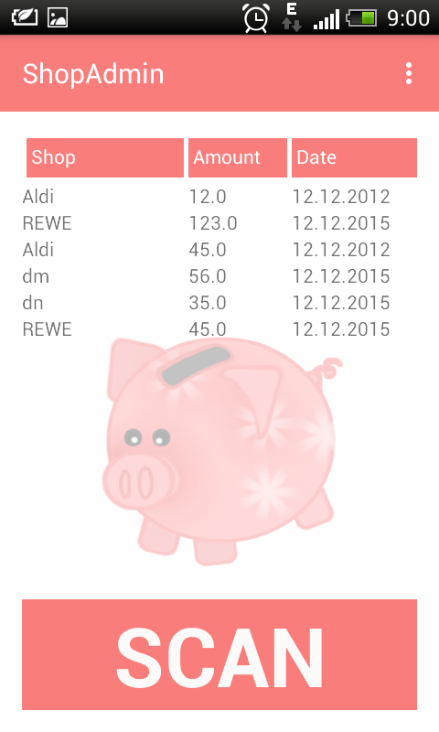
Step 6 Main page with a filled receipts table
How to use ShopAdmin
After the data has been successfully saved into the database you will be able to see all relevant information like “Shop”, “Amount” and “Date” about your purchases in a table on the main page.
If you'd like to see the receipts sorted by shopname or shop category:
1. Tap on the receipt table to switch to the reports page.
1.

Slide 9
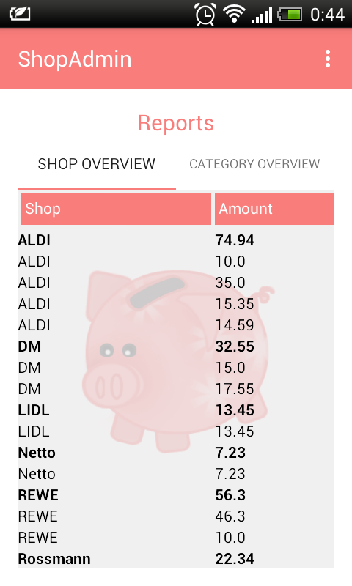
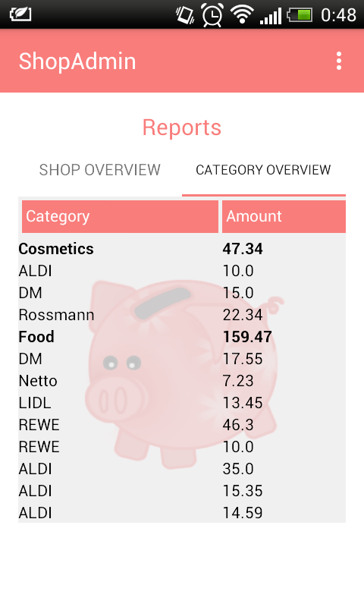
Step 7 Report Views
How to use ShopAdmin
On the Reports page you will see a table which in each line contains the receipts grouped and summed up by the shop name:
1. Tap on an arbitrary shop name to see all receipts for the given shop name
The shop name will be highlighted in bold after you tapped it.
2. Tap on the highlighted shop name one more time to close all entries that belong to this shop name
If you like to see a report with receipts grouped and summed up by category:
3. Scroll right to see the table
4. Tap on an arbitrary category to expand the list into the individual receipts for that category
The category will be highlighted after you tapped it.
5.Tap on a highlighted category one more time to close all shops that belong to this shop name
3.
1.
2.
4.
5.

